Slide 1
Human Brain Slice
Reorientation Pipeline

Slide 2
Core Pipeline Design
01
02
03
04
05
Load & Normalise
Tissue Mask
Atlas Match
PCA Rotation
Flip Resolve
PNG / TIFF / CZI → float32 [0,1]. Polarity detection: compare central vs corner medians to determine if tissue is bright or dark.
Li threshold (fallback Otsu), morphological closing, fill holes. Keep up to 3 largest connected components.
MNI152NLin2009cAsym T1w atlas. 15–25 candidate slices per axis. Fast NCC pre-screen → top-3 → full per-rotation NCC.
Score each 90° rotation: symmetry score + top-wider-than-bottom criterion. Winner recorded with NCC margin over 2nd-best.
Coronal/axial: geometric landmark (top-heavy + symmetric). Sagittal: NCC + cerebellum bottom-right landmark check.

Slide 3
Geometric Landmarks
AXIAL
CORONAL
SAGITTAL
Top-Heavy Brain + Bilateral Symmetry
Cerebellum Below Cerebrum (UD check)
Cerebellum Bottom-Right
1
Score each 90° rotation by whether top half is wider than bottom (cerebrum > cerebellum)
1
Same rotation criterion as axial: top-heavy mask + maximum symmetry score
1
Initial orientation via NCC against MNI152 atlas across all 8 transforms (4 rotations × 2 flips)
2
Among top-heavy candidates, pick the rotation with highest bilateral symmetry score
2
Additional UD flip check: locate the second-largest blob (cerebellum)
2
LR tiebreaker: pick orientation where cerebellum scores highest in bottom-right quadrant
3
No flip step: axial views are left–right symmetric by convention
3
If cerebellum centroid is in the upper half → flip vertically so it lands below
3
UD tiebreaker: ensure cerebellum centroid sits in the lower half of the frame

Slide 4
Results — Quantitative Metrics
Coronal
Sagittal
Axial
Overall
0.843
0.775
0.884
0.834
Dice
Dice
Dice
Dice
HD 0.103 NCC 0.572
HD 0.171 NCC 0.435
HD 0.063 NCC 0.775
HD 0.112 NCC 0.594
Axis | n | Dice ↑ | HD_norm ↓ | NCC ↑ | Latency (ms)
Coronal | 12 | 0.843 | 0.103 | 0.572 | ~185
Sagittal | 12 | 0.775 | 0.171 | 0.435 | ~175
Axial | 12 | 0.884 | 0.063 | 0.775 | ~190
Overall | 36 | 0.834 | 0.112 | 0.594 | ~183

Slide 5
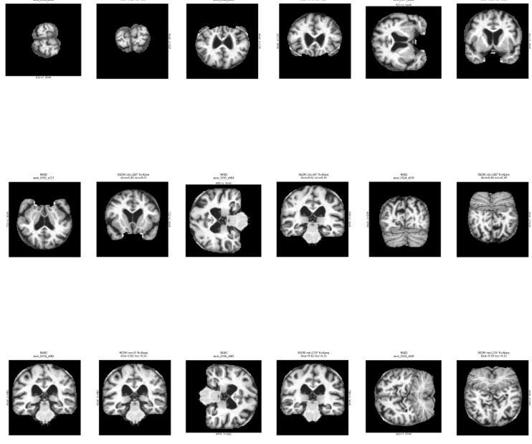
Results Grid — Coronal

Slide 6
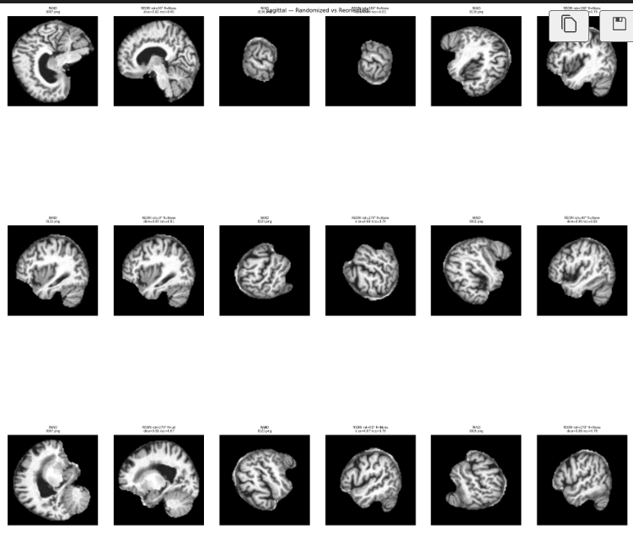
Results Grid — Sagittal

Slide 7
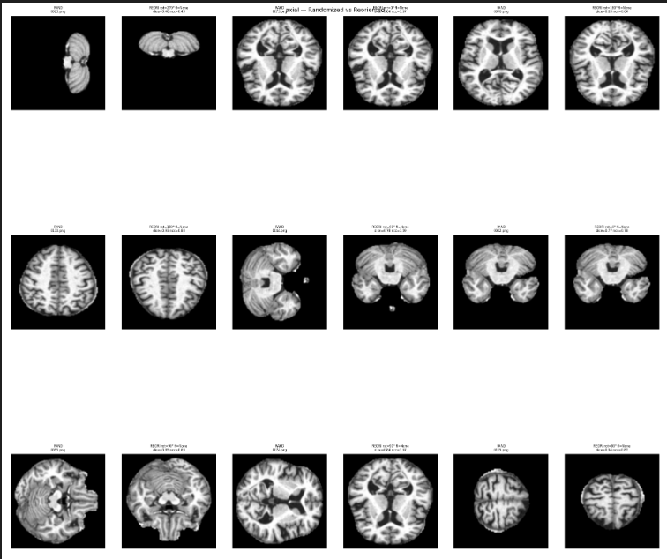
Results Grid — Axial

